Slide 1
infrastructure
October 2017

Slide 2
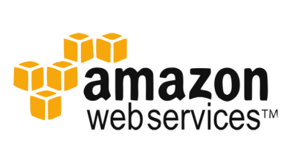
Amazon web services
Overview
Amazon Web Services (AWS) is a secure cloud services platform, offering compute power, database storage, content delivery and other functionality to help businesses scale and grow. Explore how millions of customers are currently leveraging AWS cloud products and solutions to build sophisticated applications with increased flexibility, scalability and reliability.

Slide 3
Amazon web services
Basic Functionality
Hosting a web shop
Running a JavaEE application in your private network
Meeting legal and business data archival requirements
Implementing a fault-tolerant system architecture

Slide 4

nagios
Overview
Nagios is an open-source computer-software application, monitors systems, networks and infrastructure. It offers monitoring and alerting services for servers, switches, applications and services. It alerts users when things go wrong and alerts them a second time when a the problem has been resolved. It has been around since 1999 and has a large community that provides plugins and extensions for various needs.
Since it has been around so long and many organizations use it, Nagios is the standard in network monitoring against which other solutions compare themselves. As such, it is the natural starting point for the journey through the monitoring landscape.

Slide 5
nagios
Basic Functionality
Comprehensive Monitoring
Visibility & Awareness
Problem Remediation
Proactive Planning
Reporting
Multi-Tenant Capabilities
Extendable Architecture
Stable, Reliable, and Respected Platform
Vibrant Community
Customizable Code

Slide 6

sensu
Overview
Sensu is a free and open source monitoring that handles cloud environments. Sensu allows you to monitor servers, services, application health, and business KPIs. Collect and analyze custom metrics and get notified about failures before your users do.
It is a powerful Next-Generation monitoring framework that is quickly replacing traditional monitoring systems like Zabbix, Icinga, and Nagios.

Slide 7
sensu
Basic Functionality
Execute Service Checks
Send Notifications
Collect Metrics
Documented API
Dynamic Client Registry
Self-Service Monitoring
External Input
Secure Connectivity

Slide 8
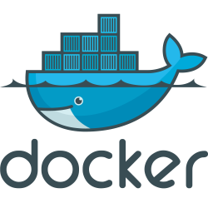
docker
Overview
A Docker is an open source platform for containers that provides a lightweight application isolated virtualization that reduces system overhead. With Docker, you can manage your infrastructure in the same ways you manage your applications. By taking advantage of Docker’s methodologies for shipping, testing, and deploying code quickly, you can significantly reduce the delay between writing code and running it in production.
It also enables to create and run applications as a single package to any kind of environment, without the consideration of differences between build and production environments.

Slide 9
docker
Basic Functionality
Responsive deployment and scaling
Docker’s container-based platform allows for highly portable workloads. Docker containers can run on a developer’s local laptop, on physical or virtual machines in a data center, on cloud providers, or in a mixture of environments.
Docker’s portability and lightweight nature also make it easy to dynamically manage workloads, scaling up or tearing down applications and services as business needs dictate, in near real time.
Running more workloads on the same hardware
Docker is lightweight and fast. It provides a viable, cost-effective alternative to hypervisor-based virtual machines, so you can use more of your compute capacity to achieve your business goals. Docker is perfect for high density environments and for small and medium deployments where you need to do more with fewer resources.

